Slide 1
Congenital abnormalities in the spinal cord
Sachith Mettananda
Department of Paediatrics
2016

Slide 2
Is due to failure of closure of neural tube between 3rd and 4th week of embryonic development

Slide 3
Aeitiology
Multifactorial
Genetic determinants
Environmental
Folate deficiency in pregnancy
Drugs (eg: valproate)
Hyperthermia
Maternal obesity/ diabetes

Slide 4
Spina bifida occulta
Meningocele
Myelomeningocele

Slide 5
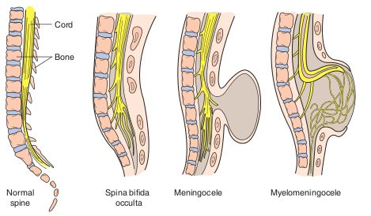
Spina bifida occulta
Meningocele
Myelomeningocele

Slide 6
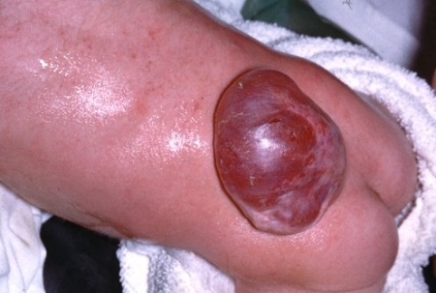
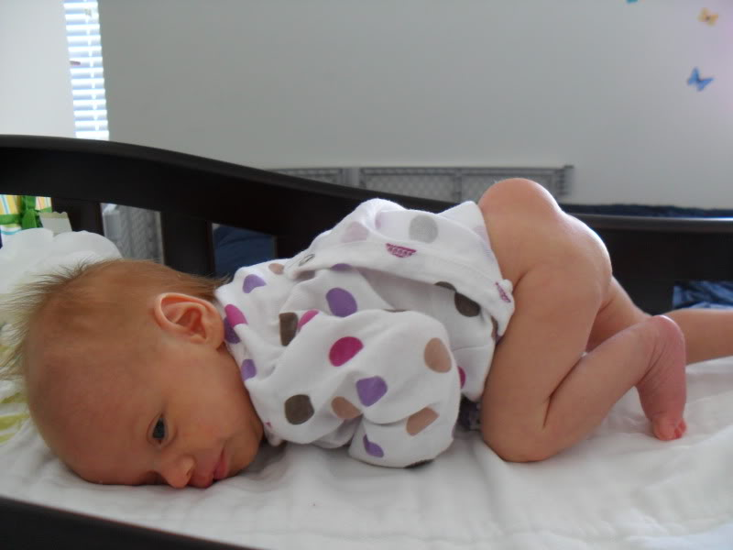
Spina bifida occulta
Meningocele
Myelomeningocele

Slide 7
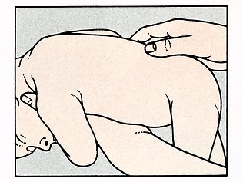
Presentation of spinal cord abnormalities
Usually detected during newborn examination

Slide 8
Spina bifida occulta
Effects
Usually asymptomatic
Cutaneous manifestation
Pit
Lump
Dermal sinus
Hemangioma
Discolouration
Hairy patch

Slide 9
Spina bifida occulta (cont.)
Diagnosis
X ray - defect in closure of the posterior vertebral arches and laminae, typically involving L5 and S1

Slide 10
Myelomeningocele
Incidence 1:4000
Clinical features
Anywhere along neuraxis – 75% lumbosacral
Cystic structure covered by a thin layer of partially epithelialized tissue
Effects depend on the level of the lesion

Slide 11
Myelomeningocele
Associated lesions
Lower limb flaccid paralysis
Sensory deficits
Bladder incontinence / retention
Bowel dysfunction – incontinence/ faecal impaction
Skeletal deformities – club foot, ankle/knee contractures, subluxation of hip
Hydrocephalus - type II Chiari malformation

Slide 12
Myelomeningocele
Management
Multidisciplinary team
Surgery-
Surgery of myelomeningocele -within days
Operative procedures for club foot/ hips
Neurogenic bladder
CISC – to minimize residual volume
Prevention of UTI – prophylactic antibiotics
Regular assessment of renal function
Artificial urinary sphincter

Slide 13
Myelomeningocele
Management
Bowel dysfunction
bowel-training with a regimen of timed enemas or suppositories
Physiotherapy
Aim – functional ambulation
Parental counselling
facts, prognostic information, management strategies and timelines
discussions with other parents of children with NTDs

Slide 14
Myelomeningocele
Prognosis
Mortality rate 10%-15%
Majority of survivors have normal intelligence
Renal dysfunction is an important determinant of mortality

Slide 15
Meningocele
Meninges herniate through a defect in posterior vertibral arches
Spinal cord is usually normal
Presentation
Fluctuant midline mass with translumination but well covered by skin

Slide 16
Meningocele (cont.)
Some are neurologically normal
Others….
Investigations
X-ray
USS
MRI - to determine the extent of neural tissue involvement (if any) and associated anomalies

Slide 17
Meningocele (cont.)
Treatment
Surgery –not urgent

Slide 18
Antenatal diagnosis
Maternal serum alpha-foeto proteins
Foetal ultrasound scan

Slide 19
Prevention of NTB
Maternal periconceptional use of folic acid supplementation
Reduces the incidence of NTDs in pregnancies at risk by at least 50%.
should be initiated before conception and continued until at least the 12th week of gestation

